Slide 1
Neural Architectures:
Tokenization Schemes
Introduction to Deep Learning: Class 5.5

Slide 2
Agenda
Tokenization
Position embeddings
Absolute position embeddings
Rotary Positional Embeddings (RoPE)
Pre-read
BPE Tokenization
Hugginsface tokenization tutorial
Positional Encoding: Attention is all you need
RoPE: RoFormer

Slide 3
Why tokenization
Text needs to be mapped to IDs, which are used to look up embeddings
But language has:
Huge vocabularies
Misspellings, rare words, names
Morphology (play/played/playing)
Goal: map text to sequence of IDs that are
Expressive enough to represent (play/played/playing are related to each other)
Compact enough (fixed vocab)
Can handle unknown words, misspellings etc.

Slide 4
Basic technique
Split on whitespace
Build vocab of top N words
Map each word to integer ID
Text: "the food was unbelievably good" Tokens: ["the","food","was","unbelievably","good"]
If “unbelievably” not in vocab → <UNK>
Problem: Either very large vocab or too many UNKs

Slide 5
Subwords: open vocabulary fix
Instead of storing every word, store pieces that can compose words.
Advantages:
can represent any new word by breaking it into pieces
handles morphology naturally
smaller vocab than word-level
fewer <UNK>
Eg.,
play = play
played = play + ed
playing = play + ing
learn = learn
learned = learn + ed
learning = learn + ing
Total number of tokens = 4 (play, learn, ed, ing)
Without subwords: 6

Slide 6
Byte Pair Encoding (BPE)
How do we learn these subwords?
BPE is an algorithm:
Start with a sequence of symbols (could be characters, bytes, or initial word pieces).
Repeatedly merge the most frequent adjacent pair into a new symbol.
Keep merging, until desired vocabulary size is reached.
So BPE answers: “Given a corpus and base symbols, how do we learn a set of frequent chunks?”

Slide 7
BPE: Example
So the initial tokenization is:
l o w </w> × 5
l o w e r </w> × 2
n e w e s t </w> × 6
w i d e s t </w> × 3
Now we repeatedly:
count adjacent symbol pairs across the corpus (weighted by counts),
merge the most frequent pair into a new symbol,
update the corpus, and repeat.
Toy corpus:
Corpus words (with counts):
low × 5
lower × 2
newest × 6
widest × 3
BPE is usually trained on words split into characters + an end-of-word marker </w> so merges don’t cross word boundaries.

Slide 8
BPE: Example
List the adjacent pairs in each word (multiply by word count).
l o w </w> × 5
Pairs: (l,o), (o,w), (w,</w>) each contributes 5
l o w e r </w> × 2
Pairs: (l,o), (o,w), (w,e), (e,r), (r,</w>) each contributes 2
n e w e s t </w> × 6
Pairs: (n,e), (e,w), (w,e), (e,s), (s,t), (t,</w>) each contributes 6
w i d e s t </w> × 3
Pairs: (w,i), (i,d), (d,e), (e,s), (s,t), (t,</w>) each contributes 3

Slide 9
BPE: Example
Now sum the big ones:
(e,s) = 6 + 3 = 9
(s,t) = 6 + 3 = 9
(t,</w>) = 6 + 3 = 9
(l,o) = 5 + 2 = 7
(o,w) = 5 + 2 = 7
(w,e) = 2 + 6 = 8
Most frequent pairs are tied at 9: (e,s), (s,t), (t,</w>).
Pick one (ties are arbitrary). Let’s merge:
(e,s)→(es)

Slide 10
BPE: Example
Iteration 1 merge: e s → es
Update corpus:
l o w </w> × 5 (unchanged)
l o w e r </w> × 2 (unchanged)
n e w es t </w> × 6
w i d es t </w> × 3

Slide 11
BPE: Example
Also still have:
(l,o) +7
(o,w) +7
(w,</w>) +5
(w,e) +2
etc.
Now totals:
(es,t) = 6 + 3 = 9
(t,</w>) = 6 + 3 = 9
(w,es) = 6
(l,o) = 7
(o,w) = 7
Iteration 2: count pairs again (focus on changed parts)
Recompute important pairs:
From n e w es t </w> × 6:
(n,e) +6
(e,w) +6
(w,es) +6
(es,t) +6
(t,</w>) +6
From w i d es t </w> × 3:
(w,i) +3
(i,d) +3
(d,es) +3
(es,t) +3
(t,</w>) +3
Pick one of the top ties again. Merge:
(es,t)→(est)
Iteration 2 merge: es t → est
Update corpus:
n e w est </w> × 6
w i d est </w> × 3 Other words unchanged.

Slide 12
BPE: Results
merge 13: ('a', 'l') count=9253
merge 14: ('o', 'n') count=8409
merge 15: ('t', 'i') count=8342
merge 16: ('o', 'r') count=8200
merge 17: ('a', 'r') count=7827
merge 18: ('r', 'e') count=6947
merge 19: ('f', '</w>') count=6515
merge 20: ('e', 'n') count=6269
merge 50: ('i', 'l') count=2501
merge 100: ('p', 'ro') count=1167
merge 150: ('h', 'is</w>') count=783
merge 200: ('at', 'ed</w>') count=513
merge 1: ('e', '</w>') count=34111
merge 2: ('s', '</w>') count=23379
merge 3: ('t', 'h') count=19805
merge 4: ('n', '</w>') count=16858
merge 5: ('d', '</w>') count=15010
merge 6: ('e', 'r') count=14565
merge 7: ('t', '</w>') count=12407
merge 8: ('i', 'n') count=11630
merge 9: ('a', 'n') count=11336
merge 10: ('th', 'e</w>') count=10256
merge 11: ('o', '</w>') count=9719
merge 12: ('y', '</w>') count=9502

Slide 13
Results
TEXT: attention contextualizes embeddings (200 merges)
TOKENS:
attention -> ['at', 't', 'en', 'tion']
contextualizes -> ['con', 't', 'ex', 't', 'u', 'al', 'i', 'z', 'es']
embeddings -> ['em', 'be', 'd', 'd', 'in', 'g', 's']
TEXT: tokenization and transformers
TOKENS:
tokenization -> ['t', 'o', 'k', 'en', 'i', 'z', 'ation']
and -> ['and']
transformers -> ['tr', 'an', 's', 'for', 'm', 'ers']
TEXT: attention contextualizes embeddings (2000 merges)
TOKENS:
attention -> ['at', 'ten', 'tion']
contextualizes -> ['cont', 'ex', 'tu', 'al', 'iz', 'es']
embeddings -> ['em', 'be', 'd', 'd', 'ings']
TEXT: tokenization and transformers
TOKENS:
tokenization -> ['to', 'k', 'en', 'ization']
and -> ['and']
transformers -> ['trans', 'form', 'ers']
TEXT: attention contextualizes embeddings (GPT2 encoder)
TOKENS:
attention -> ['att', 'ention']
contextualizes -> ['contextual', 'izes']
embeddings -> ['embed', 'd', 'ings']
TEXT: tokenization and transformers
TOKENS: ['token', 'ization', 'Ġand', 'Ġtransform', 'ers']
GPT2 encoder. Ġ indicates “there is a space before this token”, so acts as a beginning of a word marker
Allows us to separate ‘and’ between two words from ‘brand’, or ‘wand’
After 200 merges (stripping out the </w> markers)
After 2000 merges (stripping out the </w> markers)

Slide 14
Positional encodings
We need to tell the model the position of tokens in a sentence, otherwise the model will just treat the tokens as a bag of unordered tokens..
man bites dog and dog bites man will be identical
Simplest approach: Just learn a position embedding. Create a randomly initialized embedding table of size Lmax, d, where Lmax is the maximum sentence length and d is the embedding dimension
Then embedding at position t = e_t + p_t, where e_t is the token embedding and p_t is the learnt position embedding
This works ok, but can’t deal with sequence lengths beyond what’s found in the data..
We can do better by explicitly coding position information into an embedding vector

Slide 15
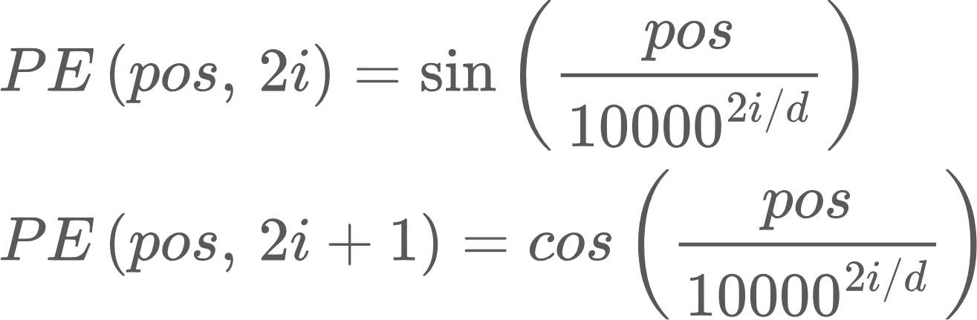
Fixed sinusoidal position embeddings
Instead of learning each position separately, can we encode the position with a deterministic mathematical pattern? This also simplifies the learning task
Use sinusoids of different frequencies
Now each position is a vector of waves.
Some dimensions change slowly, others change rapidly
The model can learn to interpret these embeddings to learn where a token is in a sentence, and the relative distance between two tokens..
Because sin(a-b) = sin(a)cos(b) - sin(b)cos(a)

Slide 16
Fixed sinusoidal position embeddings
Why use different frequencies in different coordinates? Because sin/cos repeat, and different positions could map to the same value.
Different frequencies help the model identify position over many scales.
Example: d = 4
PE(pos, 0) = sin(pos), PE(pos, 1) = cos(pos)
PE(pos, 2) = sin(pos/100), PE(pos, 3) = cos(pos/100)
The fast pair (0, 1) repeat every 2pi. So positions that differ ~6 positions will have very similar first two coordinates.. But not the second two coordinates!

Slide 17
Fixed sinusoidal position embeddings
PE(0) = [sin(0), cos(0), sin(0), cos(0)] = [0, 1, 0, 1]
PE(1) = [0.84, 0.54, 0.01, 0.9995]
PE(2) = [0.91, -0.42, 0.02, 0.9998]
If we only had the first pair, coordinates would cycle and repeat
If we only had last two, nearby positions would look too similar

Slide 18
Rotary Positional Embeddings (RoPE)
Ultimately, token embeddings are projected via Q/K/V matrices and multiplied to produce attention scores..
What we really want is attention scores to reflect the relative position between two tokens.. Rather than the absolute position of each of those tokens in the sentence.
So, instead of addition a position encoding to each token embedding, can we rotate the Q/K vectors by an amount that depends on their position, such that the dot product depends on the relative position difference? That’s the main idea behind RoPE..

Slide 19
Rotary Positional Embeddings (RoPE)
For a token tm and tn at positions m, n, calculate Q/K projections qm, kn
Take a pair of coordinates x1, x2 from qm, rotate by an angle theta that depends on m and the coordinates. Similarly, take coordinates y1, y2 from kn, rotate by an angle alpha that depends on n and the coordinates.
Key idea: The dot product depends on the difference between theta and alpha.

Slide 20
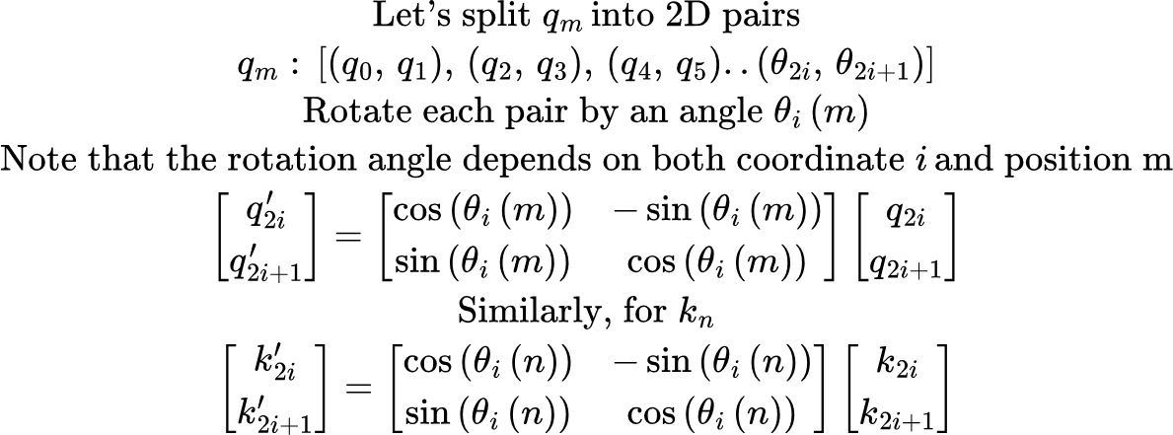
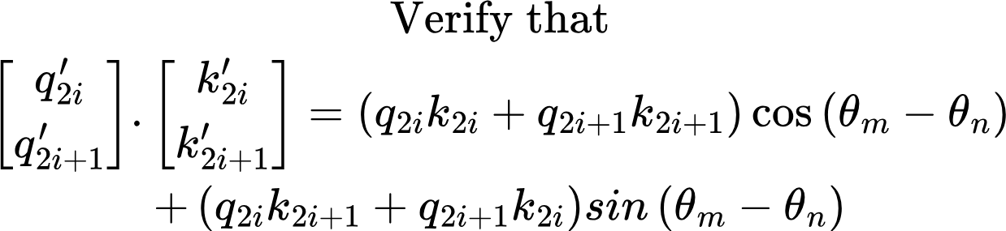
Rotary Positional Embeddings (RoPE)
Notice that the dot product (and therefore attention score) depends on the difference in the angle!

Slide 21
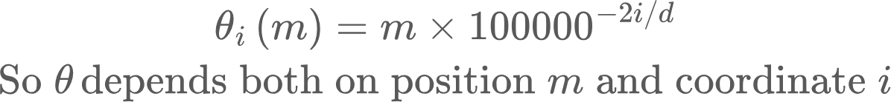
Rotary Positional Embeddings (RoPE)
Choosing theta
Because of the dependence on coordinate i, different coordinates use different frequencies and aliasing due to periodicity of sin/cos is prevented.
Recall:
Absolute positional embeddings add positional embeddings. The model needs to learn how to calculate relative positions by itself
RoPE rotates the K/Q projections by position dependent angles such that the dot product between query and key vectors depends on the position difference.

